Slide 1
BIEN 401 Biomedical Mass Transport Class 13 Oxygen Transport
notes prepared by
Dr. Louis Reis
Created on 4/5/2022

Slide 2
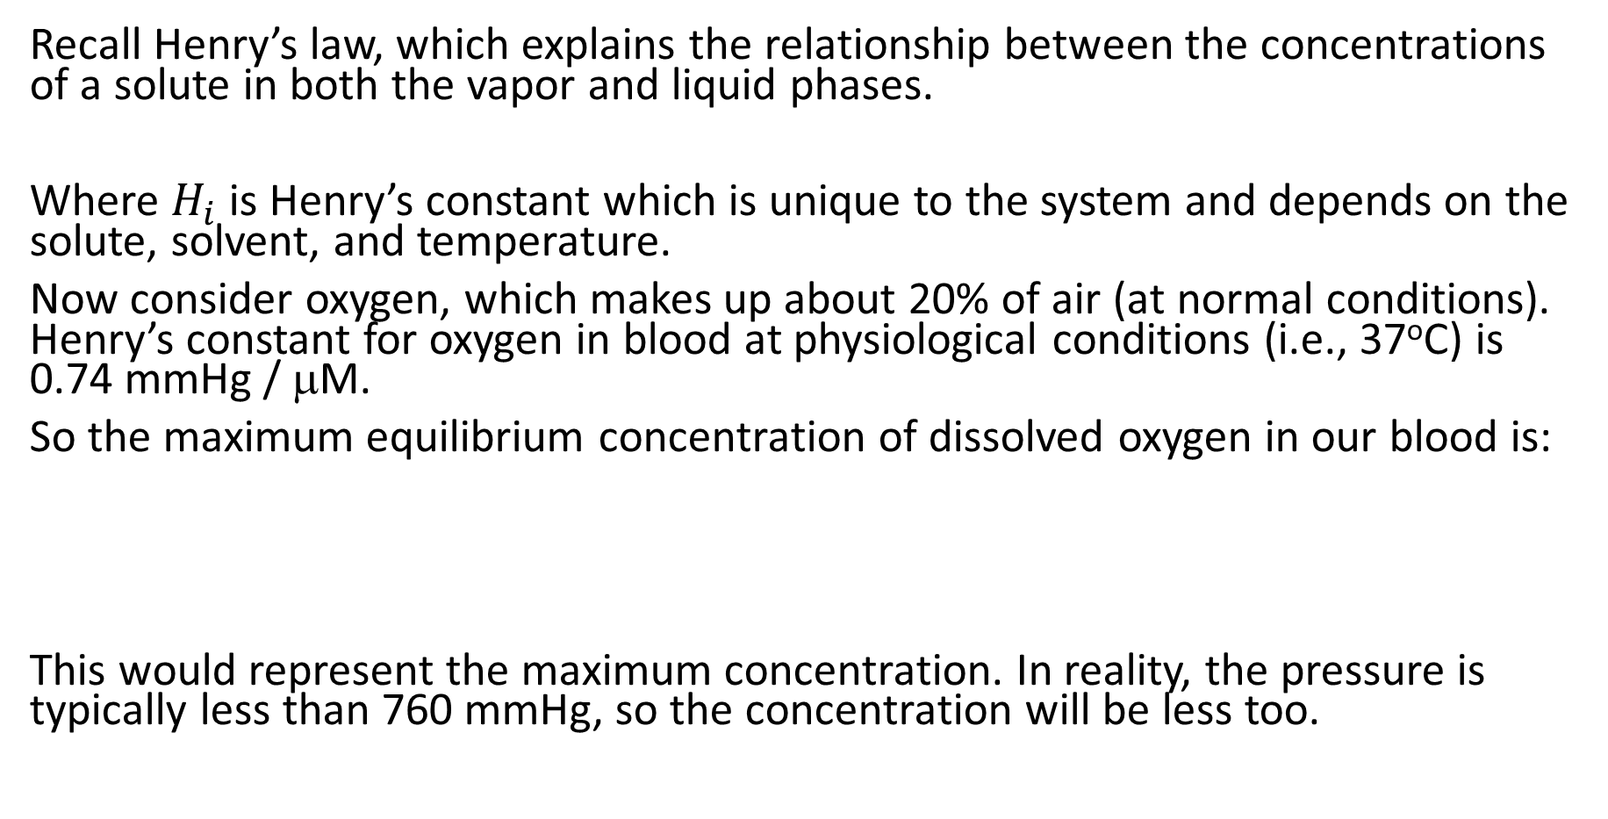
Henry’s Law
Recall Henry’s law, which explains the relationship between the concentrations of a solute in both the vapor and liquid phases.
Where $H_{i}$ is Henry’s constant which is unique to the system and depends on the solute, solvent, and temperature.
Now consider oxygen, which makes up about 20% of air (at normal conditions). Henry’s constant for oxygen in blood at physiological conditions (i.e., 37ºC) is 0.74 mmHg / μM.
So the maximum equilibrium concentration of dissolved oxygen in our blood is:
This would represent the maximum concentration. In reality, the pressure is typically less than 760 mmHg, so the concentration will be less too.

Slide 3
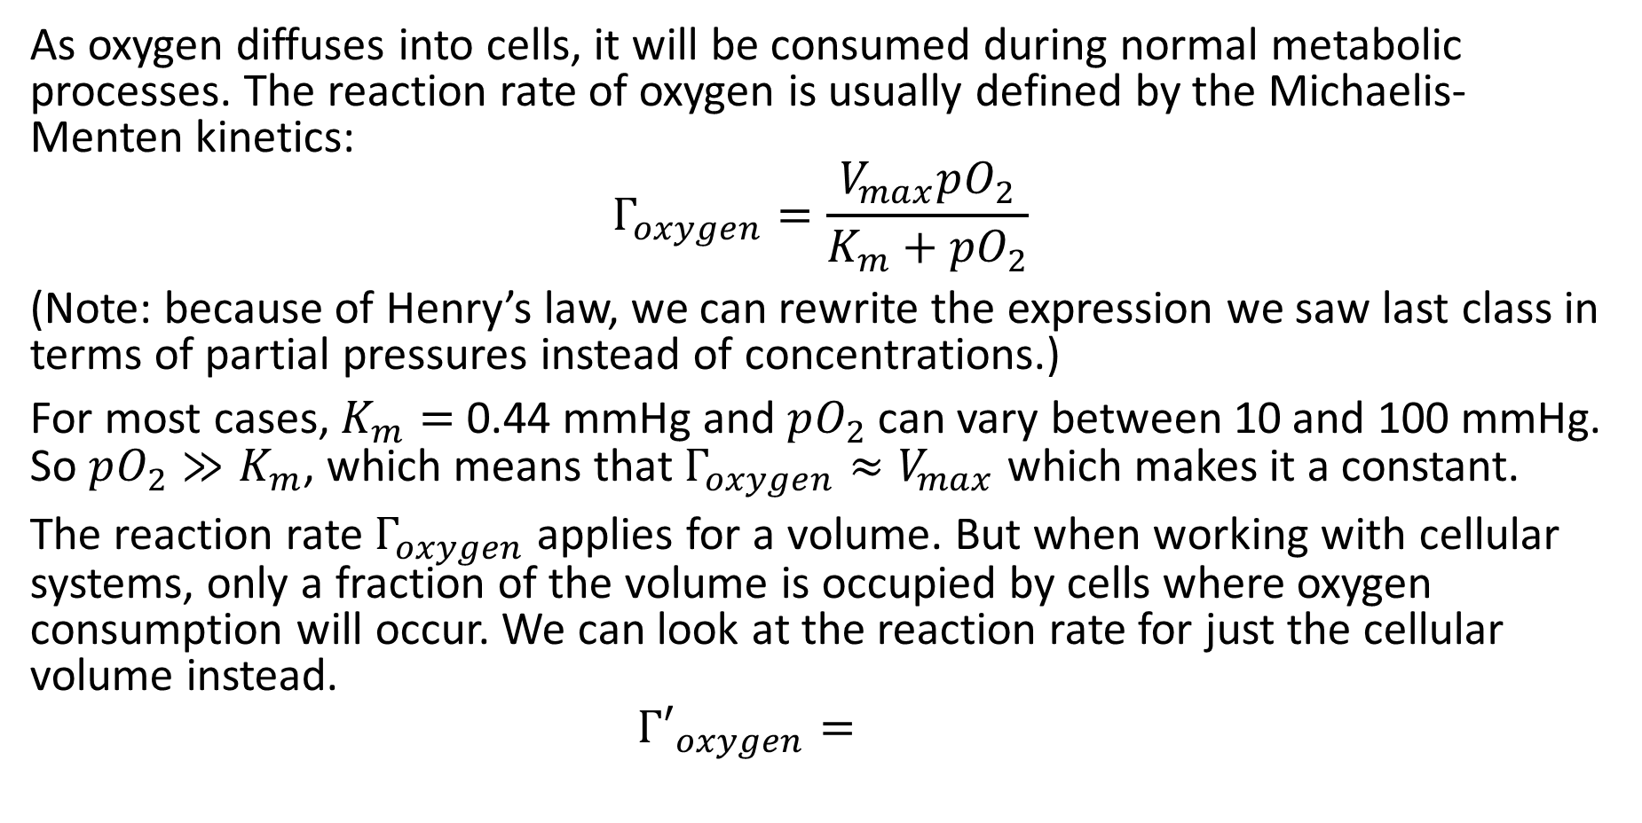
Oxygen Consumption
As oxygen diffuses into cells, it will be consumed during normal metabolic processes. The reaction rate of oxygen is usually defined by the Michaelis-Menten kinetics:
$$Γ_{oxygen}=\frac{V_{max}pO_{2}}{K_{m}+pO_{2}}$$
(Note: because of Henry’s law, we can rewrite the expression we saw last class in terms of partial pressures instead of concentrations.)
For most cases, $K_{m}=$ 0.44 mmHg and $pO_{2}$ can vary between 10 and 100 mmHg. So $pO_{2}≫K_{m}$, which means that $Γ_{oxygen}≈V_{max}$ which makes it a constant.
The reaction rate $Γ_{oxygen}$ applies for a volume. But when working with cellular systems, only a fraction of the volume is occupied by cells where oxygen consumption will occur. We can look at the reaction rate for just the cellular volume instead.
$${Γ′}_{oxygen}=$$

Slide 4
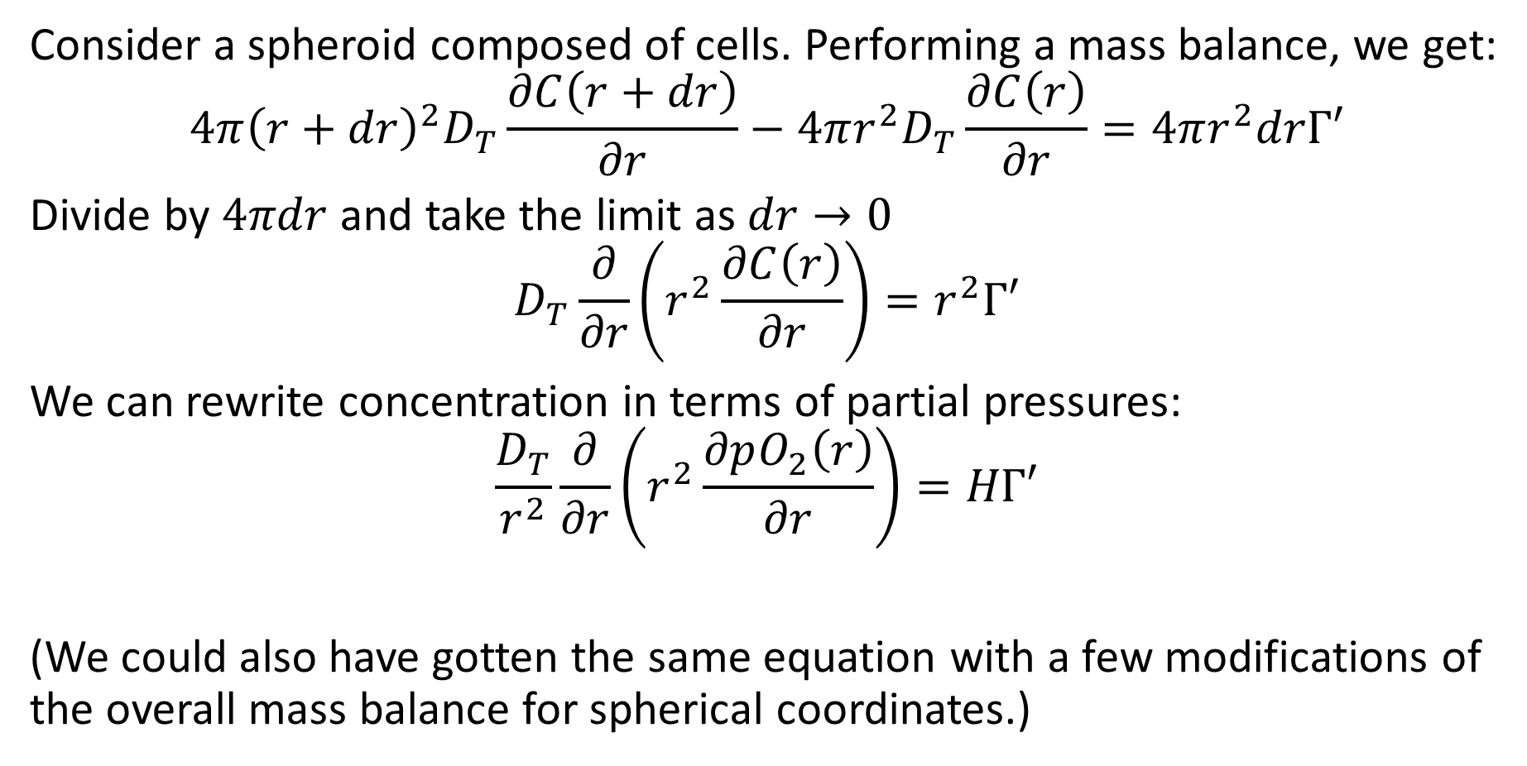
Oxygen Transport in a Spheroid
Consider a spheroid composed of cells. Performing a mass balance, we get:
$$4π{\left(r+dr\right)}^{2}D_{T}\frac{∂C\left(r+dr\right)}{∂r}−4πr^{2}D_{T}\frac{∂C\left(r\right)}{∂r}=4πr^{2}drΓ′$$
Divide by $4πdr$ and take the limit as $dr→0$
$$D_{T}\frac{∂}{∂r}\left(r^{2}\frac{∂C\left(r\right)}{∂r}\right)=r^{2}Γ′$$
We can rewrite concentration in terms of partial pressures:
$$\frac{D_{T}}{r^{2}}\frac{∂}{∂r}\left(r^{2}\frac{∂pO_{2}\left(r\right)}{∂r}\right)=HΓ′$$
(We could also have gotten the same equation with a few modifications of the overall mass balance for spherical coordinates.)

Slide 5
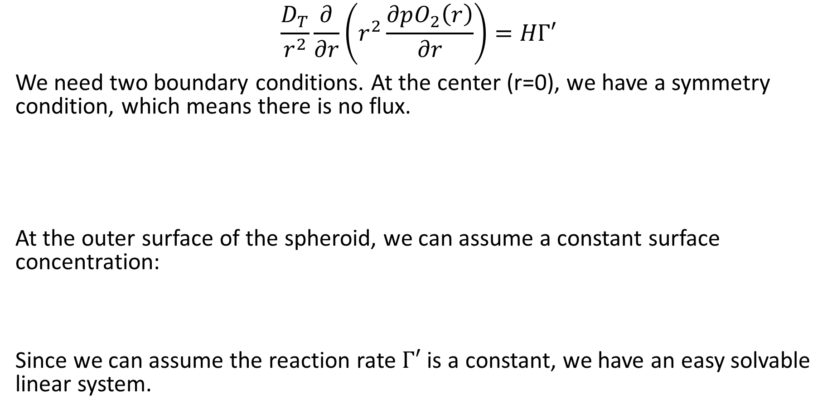
Oxygen Transport in a Spheroid
$$\frac{D_{T}}{r^{2}}\frac{∂}{∂r}\left(r^{2}\frac{∂pO_{2}\left(r\right)}{∂r}\right)=HΓ′$$
We need two boundary conditions. At the center (r=0), we have a symmetry condition, which means there is no flux.
At the outer surface of the spheroid, we can assume a constant surface concentration:
Since we can assume the reaction rate $Γ′$ is a constant, we have an easy solvable linear system.

Slide 6
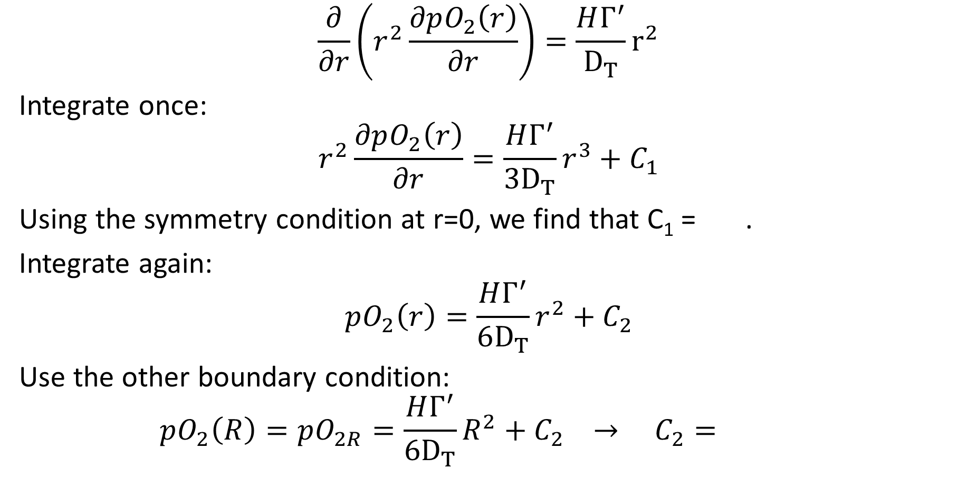
Oxygen Transport in a Spheroid
$$\frac{∂}{∂r}\left(r^{2}\frac{∂pO_{2}\left(r\right)}{∂r}\right)=\frac{HΓ^{′}}{D_{T}}r^{2}$$
Integrate once:
$$r^{2}\frac{∂pO_{2}\left(r\right)}{∂r}=\frac{HΓ^{′}}{3D_{T}}r^{3}+C_{1}$$
Using the symmetry condition at r=0, we find that C₁ = .
Integrate again:
$$pO_{2}\left(r\right)=\frac{HΓ^{′}}{6D_{T}}r^{2}+C_{2}$$
Use the other boundary condition:
$$pO_{2}\left(R\right)=pO_{2R}=\frac{HΓ^{′}}{6D_{T}}R^{2}+C_{2} → C_{2}=$$

Slide 7
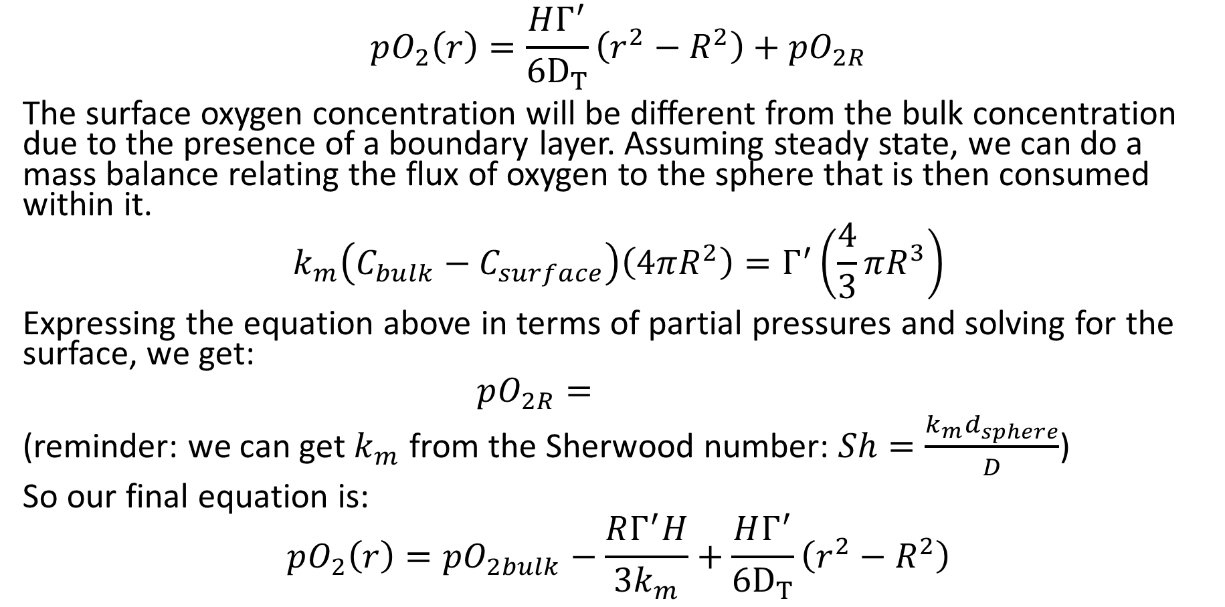
Oxygen Transport in a Spheroid
$$pO_{2}\left(r\right)=\frac{HΓ^{′}}{6D_{T}}\left(r^{2}−R^{2}\right)+pO_{2R}$$
The surface oxygen concentration will be different from the bulk concentration due to the presence of a boundary layer. Assuming steady state, we can do a mass balance relating the flux of oxygen to the sphere that is then consumed within it.
$$k_{m}\left(C_{bulk}−C_{surface}\right)\left(4πR^{2}\right)=Γ^{′}\left(\frac{4}{3}πR^{3}\right)$$
Expressing the equation above in terms of partial pressures and solving for the surface, we get:
$$pO_{2R}=$$
(reminder: we can get $k_{m}$ from the Sherwood number: $Sh=\frac{k_{m}d_{sphere}}{D}$)
So our final equation is:
$$pO_{2}\left(r\right)=pO_{2bulk}−\frac{RΓ^{′}H}{3k_{m}}+\frac{HΓ^{′}}{6D_{T}}\left(r^{2}−R^{2}\right)$$

Slide 8
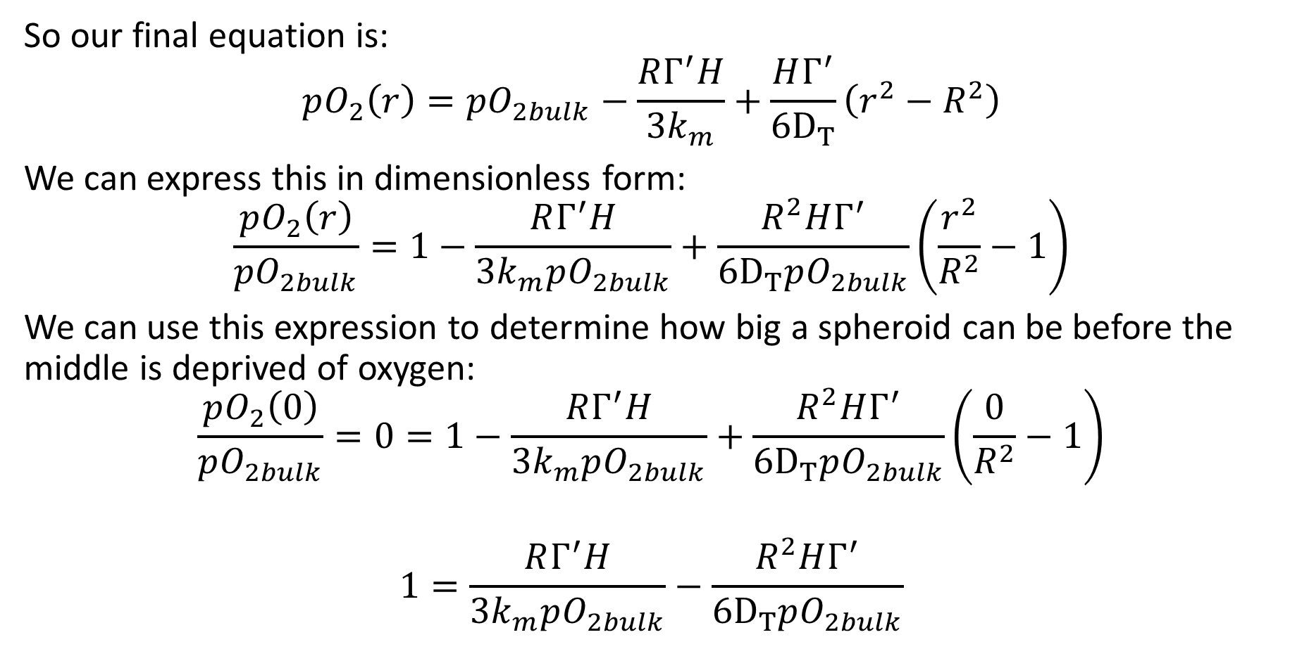
Oxygen Transport in a Spheroid
So our final equation is:
$$pO_{2}\left(r\right)=pO_{2bulk}−\frac{RΓ^{′}H}{3k_{m}}+\frac{HΓ^{′}}{6D_{T}}\left(r^{2}−R^{2}\right)$$
We can express this in dimensionless form:
$$\frac{pO_{2}\left(r\right)}{pO_{2bulk}}=1−\frac{RΓ^{′}H}{3k_{m}pO_{2bulk}}+\frac{R^{2}HΓ^{′}}{6D_{T}pO_{2bulk}}\left(\frac{r^{2}}{R^{2}}−1\right)$$
We can use this expression to determine how big a spheroid can be before the middle is deprived of oxygen:
$$\frac{pO_{2}\left(0\right)}{pO_{2bulk}}=0=1−\frac{RΓ^{′}H}{3k_{m}pO_{2bulk}}+\frac{R^{2}HΓ^{′}}{6D_{T}pO_{2bulk}}\left(\frac{0}{R^{2}}−1\right)$$
$$1=\frac{RΓ^{′}H}{3k_{m}pO_{2bulk}}−\frac{R^{2}HΓ^{′}}{6D_{T}pO_{2bulk}}$$

Slide 9
Oxygen Transport in Tissue
We can see that the size of cellular mass is dependent on the rate oxygen can diffuse into the mass and consumed by the cells. We also saw that the amount oxygen that can dissolve in a solvent (water, blood, etc.) is quite small. In order to support a larger and more complex body of cells, our circulatory system incorporates a second and far more efficient way of transporting oxygen.
_______________ can increase the concentration of oxygen in our blood from roughly 130 μM of dissolved oxygen to _________ carried by Hb. If all of the Hb is saturated, the oxygen concentration can be as high as _________.

Slide 10
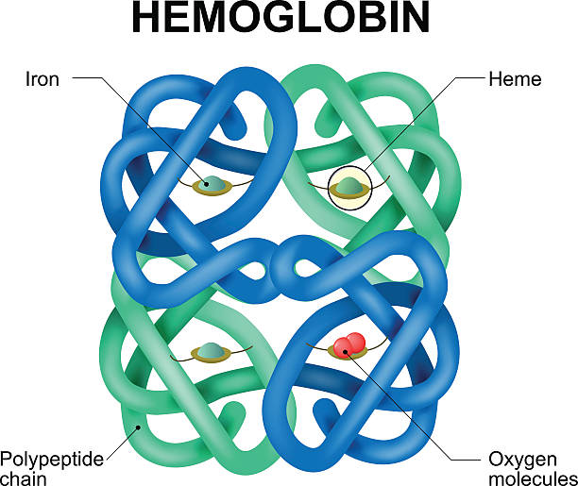
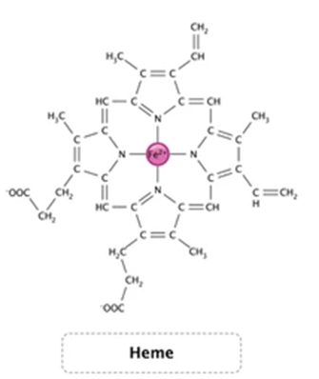
Hemoglobin
Hemoglobin is composed of 4 polypeptide chains (____________) held together by noncovalent bonds.
The molecule is fairly spherical with a radius of 5.5 nm and a molecular weight of 68 kDa.
Hb functionality comes from the ______ groups found on each chain.
The iron atom in the center of the heme can form up to 6 bonds; 4 of these bonds are with nitrogen atoms to form pyrrole rings.
The remaining 2 bonds allow for 2 oxygen molecules to bind to the heme groups.

Slide 11
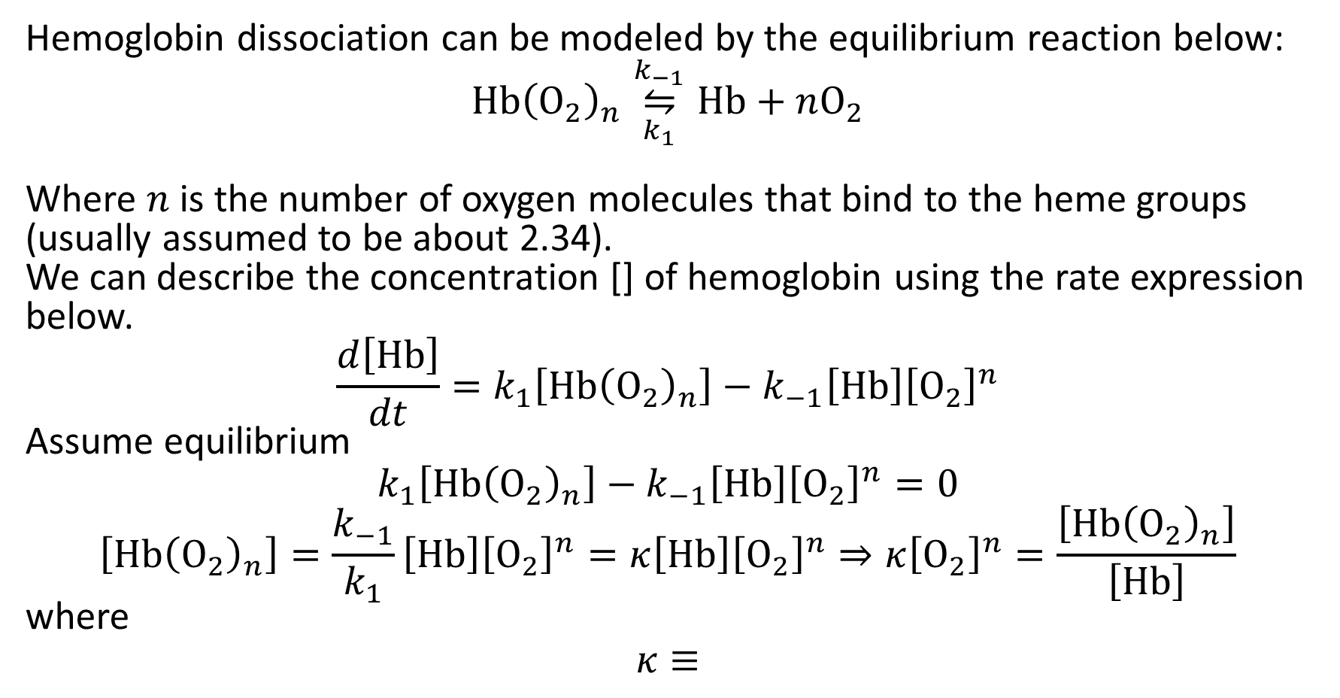
Hill Equation
Hemoglobin dissociation can be modeled by the equilibrium reaction below:
$$\text{Hb}{\left({\text{O}}_{2}\right)}_{n}\overset{k_{−1}}{\underset{k_{1}}{⇋}}\text{Hb}+n{\text{O}}_{2}$$
Where $n$ is the number of oxygen molecules that bind to the heme groups (usually assumed to be about 2.34).
We can describe the concentration [] of hemoglobin using the rate expression below.
$$\frac{d\left[\text{Hb}\right]}{dt}=k_{1}\left[\text{Hb}{\left({\text{O}}_{2}\right)}_{n}\right]−k_{−1}\left[\text{Hb}\right]{\left[{\text{O}}_{2}\right]}^{n}$$
Assume equilibrium
$$k_{1}\left[\text{Hb}{\left({\text{O}}_{2}\right)}_{n}\right]−k_{−1}\left[\text{Hb}\right]{\left[{\text{O}}_{2}\right]}^{n}=0$$
$$\left[\text{Hb}{\left({\text{O}}_{2}\right)}_{n}\right]=\frac{k_{−1}}{k_{1}}\left[\text{Hb}\right]{\left[{\text{O}}_{2}\right]}^{n}=κ\left[\text{Hb}\right]{\left[{\text{O}}_{2}\right]}^{n}⇒{κ\left[{\text{O}}_{2}\right]}^{n}=\frac{\left[\text{Hb}{\left({\text{O}}_{2}\right)}_{n}\right]}{\left[\text{Hb}\right]}$$
where
$$κ≡$$

Slide 12
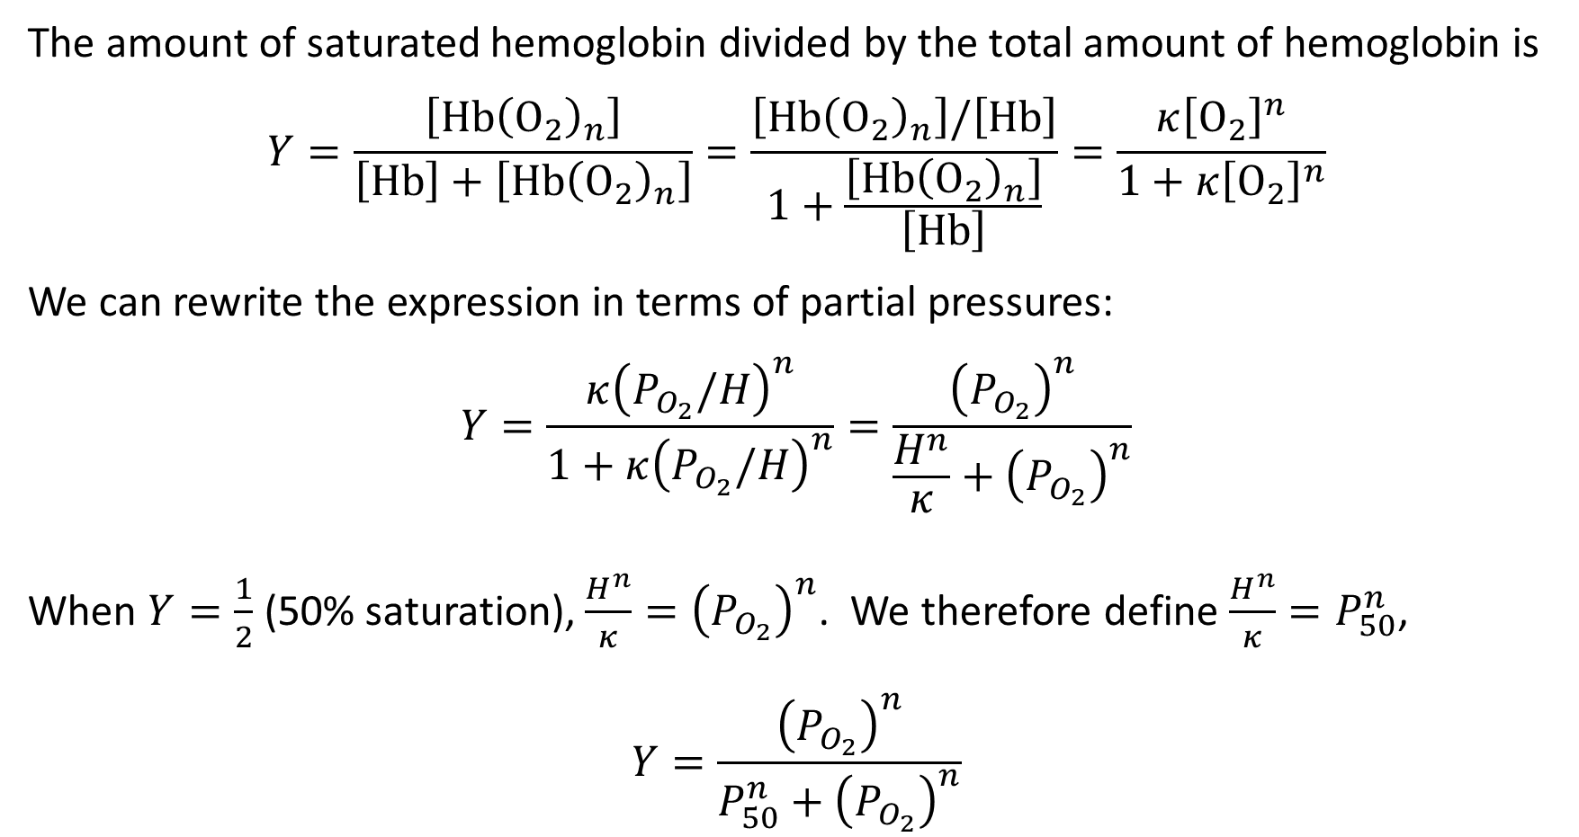
Hill Equation
The amount of saturated hemoglobin divided by the total amount of hemoglobin is
$$Y=\frac{\left[\text{Hb}{\left({\text{O}}_{2}\right)}_{n}\right]}{\left[\text{Hb}\right]+\left[\text{Hb}{\left({\text{O}}_{2}\right)}_{n}\right]}=\frac{\left[\text{Hb}{\left({\text{O}}_{2}\right)}_{n}\right]/\left[\text{Hb}\right]}{1+\frac{\left[\text{Hb}{\left({\text{O}}_{2}\right)}_{n}\right]}{\left[\text{Hb}\right]}}=\frac{κ{\left[{\text{O}}_{2}\right]}^{n}}{1+{κ\left[{\text{O}}_{2}\right]}^{n}}$$
We can rewrite the expression in terms of partial pressures:
$$Y=\frac{κ{\left(P_{O_{2}}/H\right)}^{n}}{1+κ{\left(P_{O_{2}}/H\right)}^{n}}=\frac{{\left(P_{O_{2}}\right)}^{n}}{\frac{H^{n}}{κ}+{\left(P_{O_{2}}\right)}^{n}}$$
When $Y=\frac{1}{2}$ (50% saturation), $\frac{H^{n}}{κ}={\left(P_{O_{2}}\right)}^{n}$. We therefore define $\frac{H^{n}}{κ}=P_{50}^{n}$,
$$Y=\frac{{\left(P_{O_{2}}\right)}^{n}}{P_{50}^{n}+{\left(P_{O_{2}}\right)}^{n}}$$

Slide 13
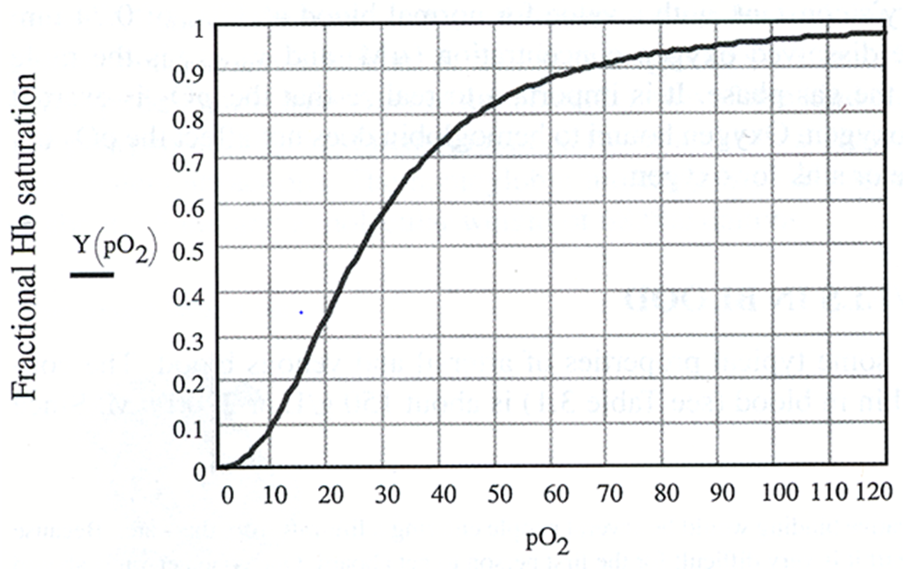
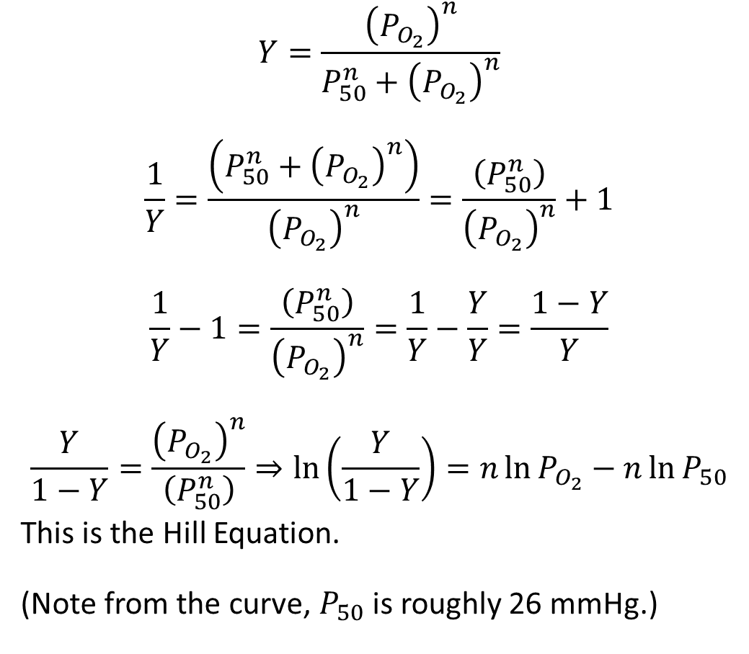
Hill Equation
$$Y=\frac{{\left(P_{O_{2}}\right)}^{n}}{P_{50}^{n}+{\left(P_{O_{2}}\right)}^{n}}$$
$$\frac{1}{Y}=\frac{\left(P_{50}^{n}+{\left(P_{O_{2}}\right)}^{n}\right)}{{\left(P_{O_{2}}\right)}^{n}}=\frac{\left(P_{50}^{n}\right)}{{\left(P_{O_{2}}\right)}^{n}}+1$$
$$\frac{1}{Y}−1=\frac{\left(P_{50}^{n}\right)}{{\left(P_{O_{2}}\right)}^{n}}=\frac{1}{Y}−\frac{Y}{Y}=\frac{1−Y}{Y}$$
$$\frac{Y}{1−Y}=\frac{{\left(P_{O_{2}}\right)}^{n}}{\left(P_{50}^{n}\right)}⇒\ln\left(\frac{Y}{1−Y}\right)=n\ln{P_{O_{2}}}−n\ln{P_{50}}$$
This is the Hill Equation.
(Note from the curve, $P_{50}$ is roughly 26 mmHg.)
(mmHg)

Slide 14
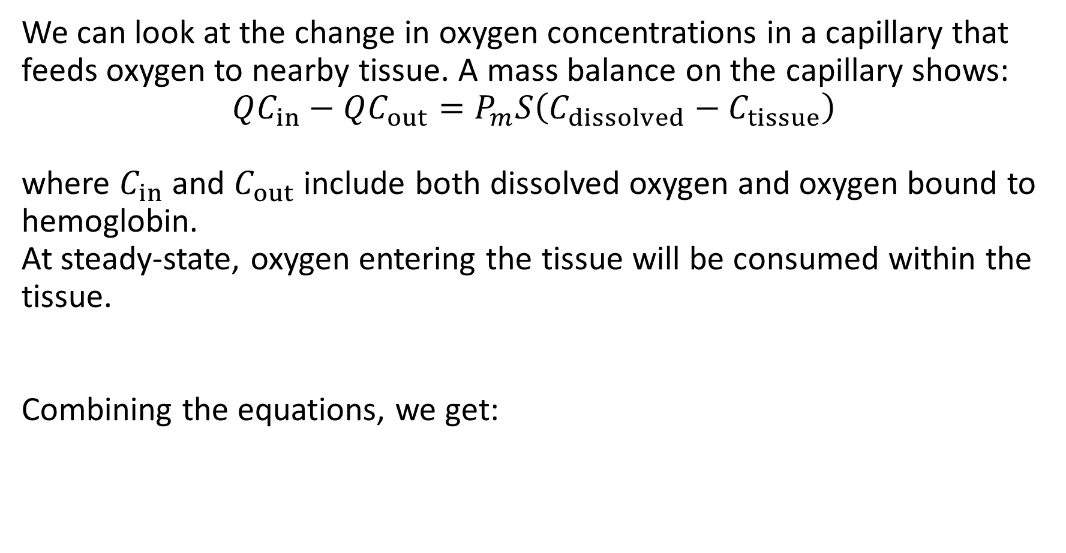
Tissue Oxygenation
We can look at the change in oxygen concentrations in a capillary that feeds oxygen to nearby tissue. A mass balance on the capillary shows:
$$QC_{in}−QC_{out}=P_{m}S\left(C_{dissolved}−C_{tissue}\right)$$
where $C_{in}$ and $C_{out}$ include both dissolved oxygen and oxygen bound to hemoglobin.
At steady-state, oxygen entering the tissue will be consumed within the tissue.
Combining the equations, we get:

Slide 15
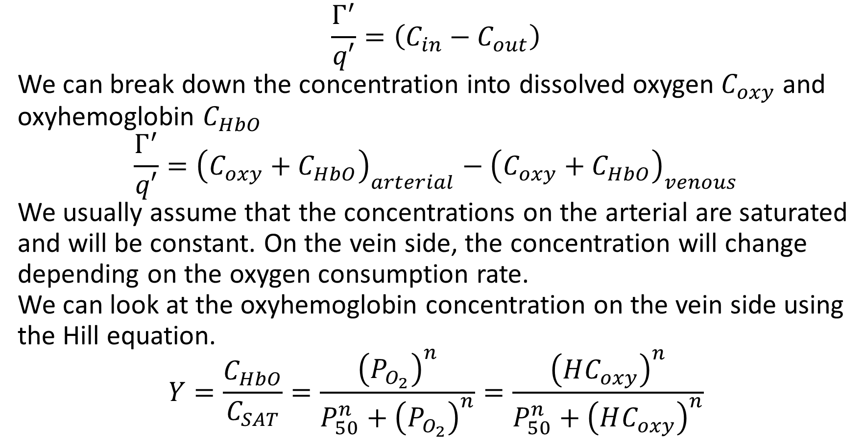
Tissue Oxygenation
$$\frac{Γ^{′}}{q′}=\left(C_{in}−C_{out}\right)$$
We can break down the concentration into dissolved oxygen $C_{oxy}$ and oxyhemoglobin $C_{HbO}$
$$\frac{Γ^{′}}{q′}={\left(C_{oxy}+C_{HbO}\right)}_{arterial}−{\left(C_{oxy}+C_{HbO}\right)}_{venous}$$
We usually assume that the concentrations on the arterial are saturated and will be constant. On the vein side, the concentration will change depending on the oxygen consumption rate.
We can look at the oxyhemoglobin concentration on the vein side using the Hill equation.
$$Y=\frac{C_{HbO}}{C_{SAT}}=\frac{{\left(P_{O_{2}}\right)}^{n}}{P_{50}^{n}+{\left(P_{O_{2}}\right)}^{n}}=\frac{{\left(HC_{oxy}\right)}^{n}}{P_{50}^{n}+{\left(HC_{oxy}\right)}^{n}}$$

Slide 16
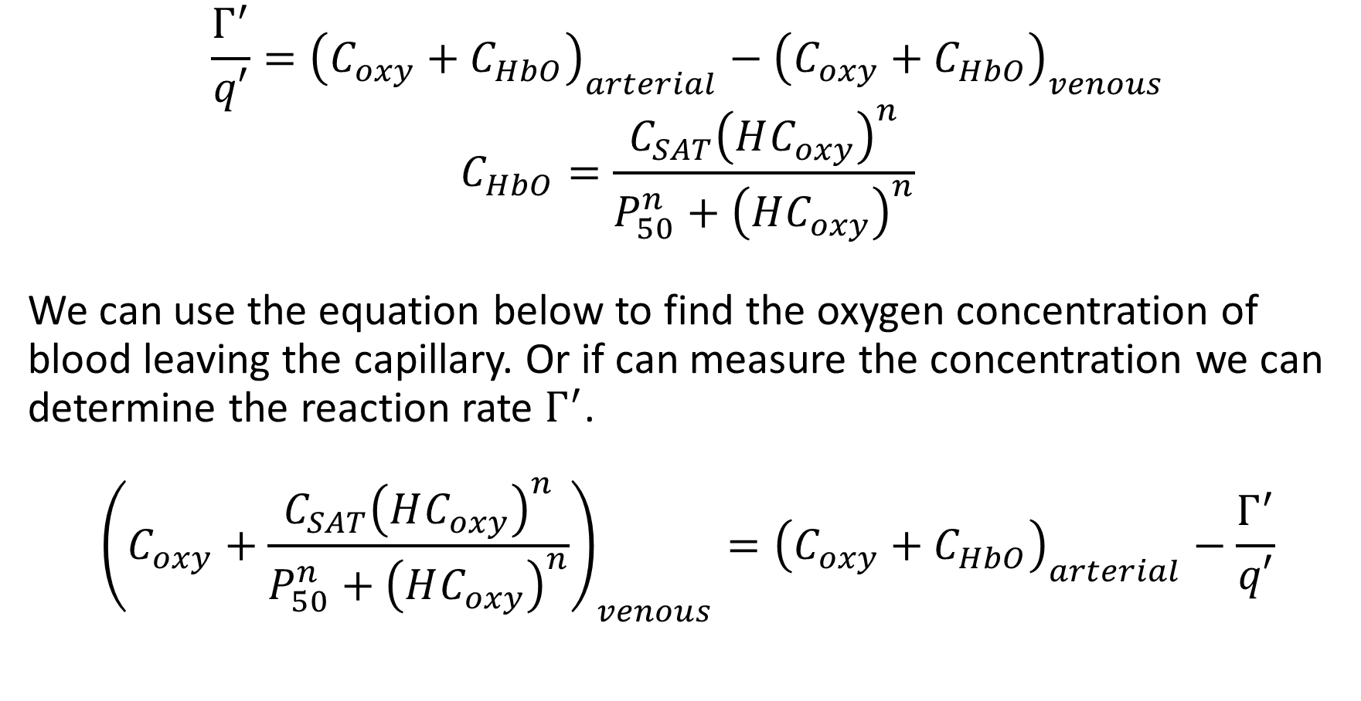
Tissue Oxygenation
$$\frac{Γ^{′}}{q′}={\left(C_{oxy}+C_{HbO}\right)}_{arterial}−{\left(C_{oxy}+C_{HbO}\right)}_{venous}$$
$$C_{HbO}=\frac{C_{SAT}{\left(HC_{oxy}\right)}^{n}}{P_{50}^{n}+{\left(HC_{oxy}\right)}^{n}}$$
We can use the equation below to find the oxygen concentration of blood leaving the capillary. Or if can measure the concentration we can determine the reaction rate $Γ^{′}$.
$${\left(C_{oxy}+\frac{C_{SAT}{\left(HC_{oxy}\right)}^{n}}{P_{50}^{n}+{\left(HC_{oxy}\right)}^{n}}\right)}_{venous}={\left(C_{oxy}+C_{HbO}\right)}_{arterial}−\frac{Γ^{′}}{q′}$$

Slide 17
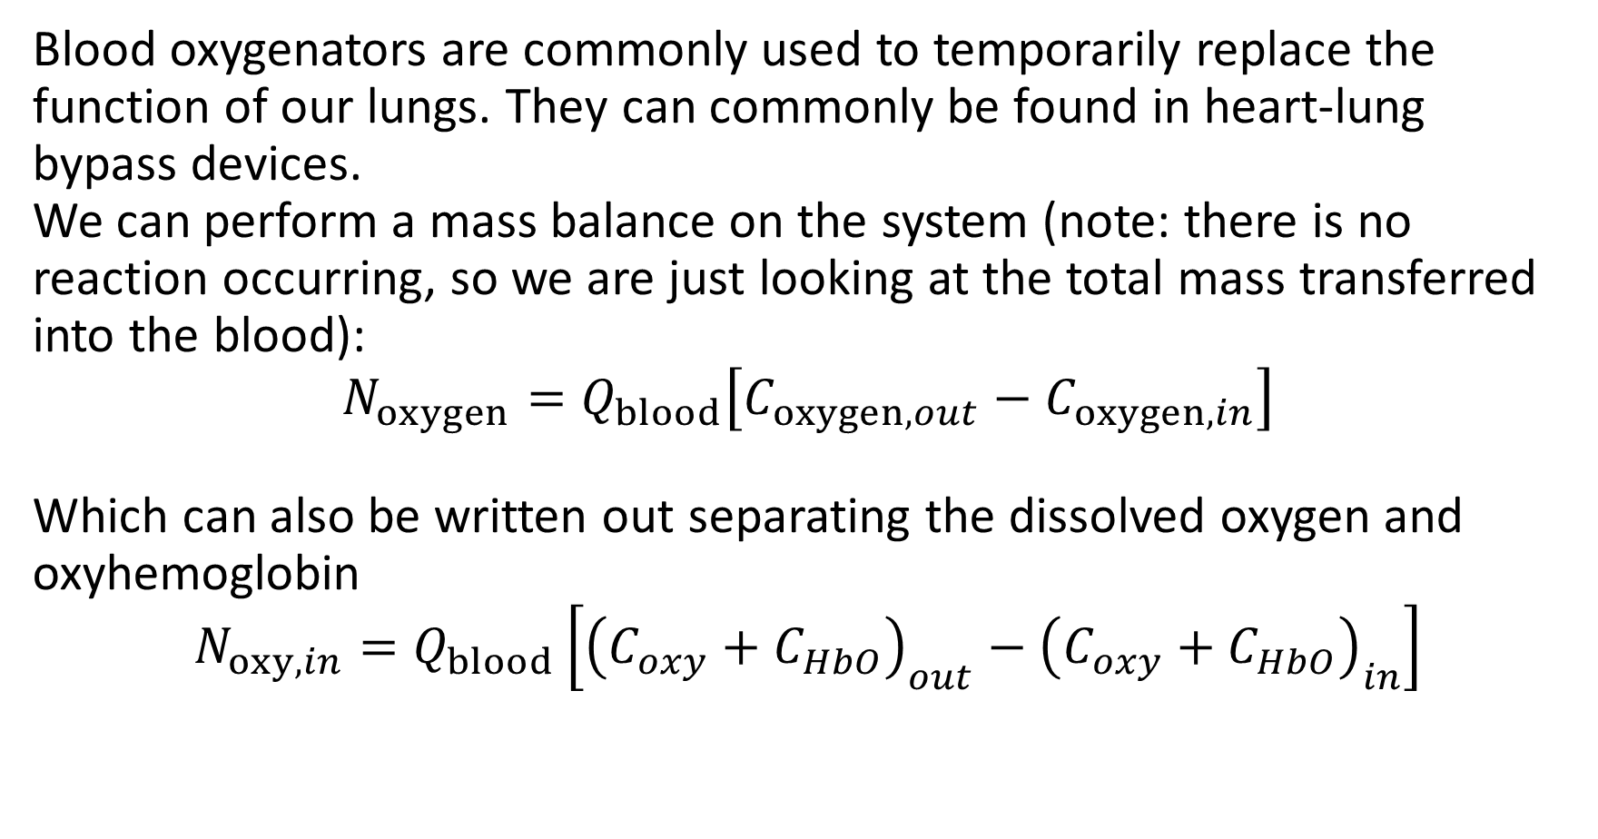
Blood Oxygenator
Blood oxygenators are commonly used to temporarily replace the function of our lungs. They can commonly be found in heart-lung bypass devices.
We can perform a mass balance on the system (note: there is no reaction occurring, so we are just looking at the total mass transferred into the blood):
$$N_{oxygen}=Q_{blood}\left[C_{oxygen,out}−C_{oxygen,in}\right]$$
Which can also be written out separating the dissolved oxygen and oxyhemoglobin
$$N_{oxy,in}=Q_{blood}\left[{\left(C_{oxy}+C_{HbO}\right)}_{out}−{\left(C_{oxy}+C_{HbO}\right)}_{in}\right]$$

Slide 18
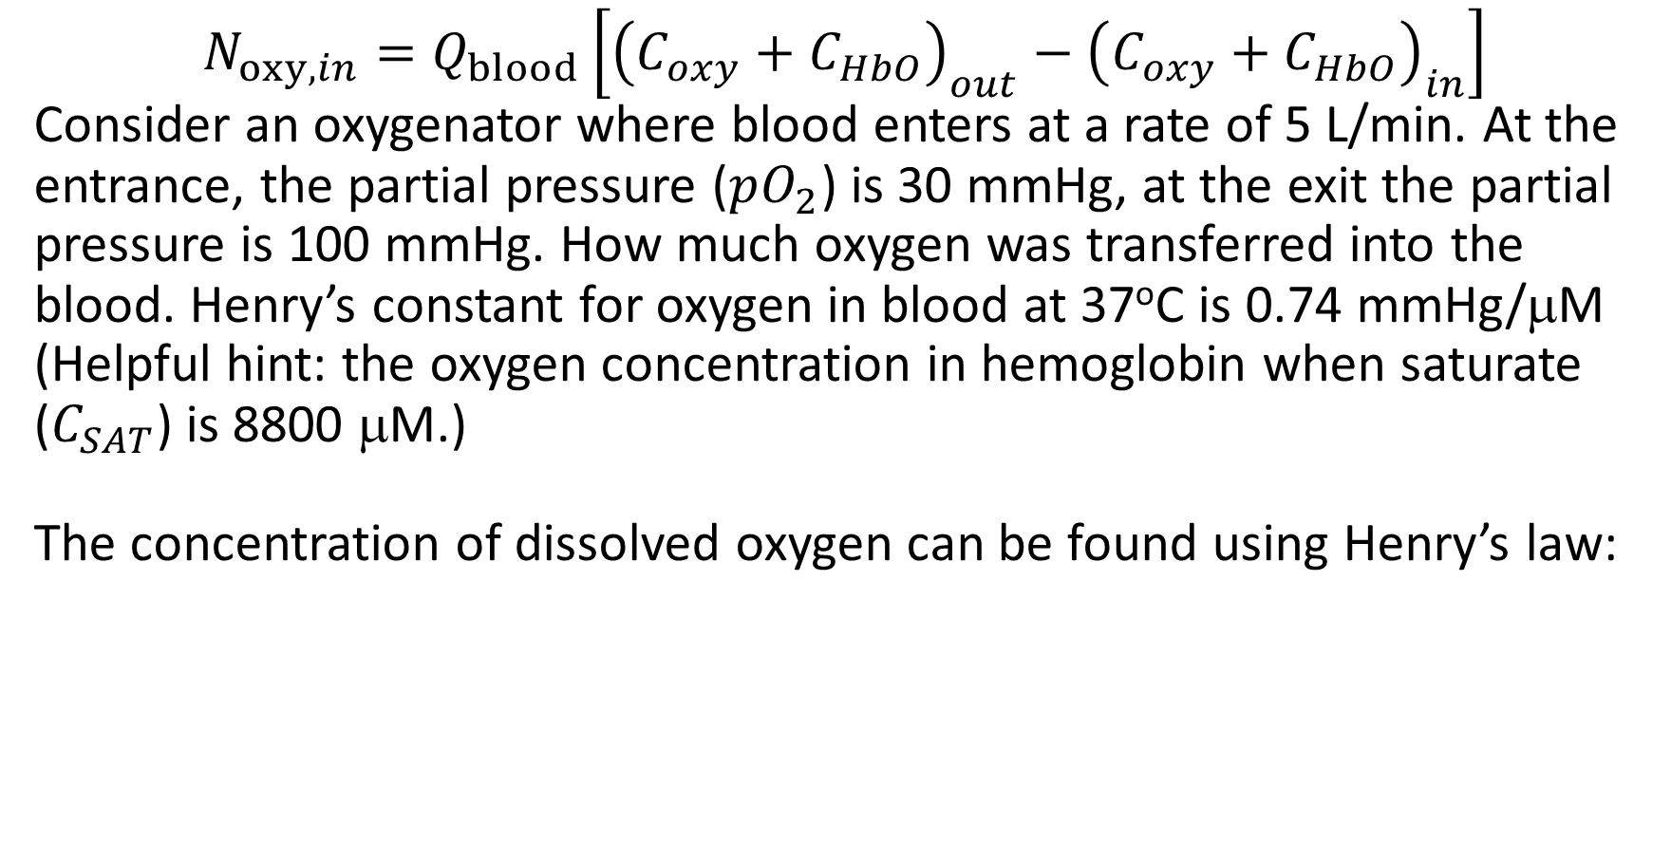
Blood Oxygenator-example
$$N_{oxy,in}=Q_{blood}\left[{\left(C_{oxy}+C_{HbO}\right)}_{out}−{\left(C_{oxy}+C_{HbO}\right)}_{in}\right]$$
Consider an oxygenator where blood enters at a rate of 5 L/min. At the entrance, the partial pressure ($pO_{2}$) is 30 mmHg, at the exit the partial pressure is 100 mmHg. How much oxygen was transferred into the blood. Henry’s constant for oxygen in blood at 37ºC is 0.74 mmHg/μM
(Helpful hint: the oxygen concentration in hemoglobin when saturate ($C_{SAT}$) is 8800 μM.)
The concentration of dissolved oxygen can be found using Henry’s law:

Slide 19
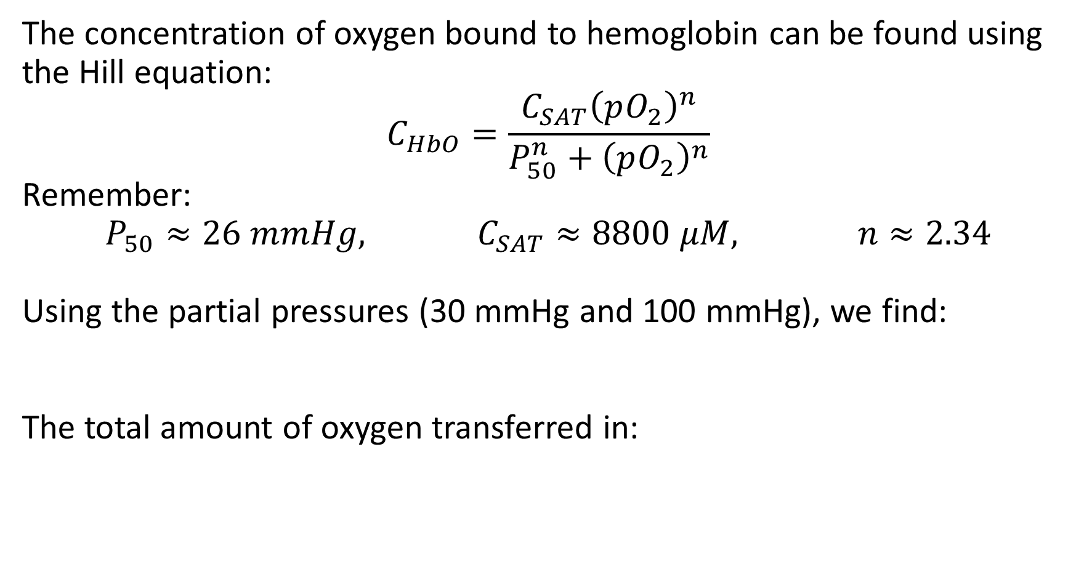
Blood Oxygenator-example
The concentration of oxygen bound to hemoglobin can be found using the Hill equation:
$$C_{HbO}=\frac{C_{SAT}{\left(pO_{2}\right)}^{n}}{P_{50}^{n}+{\left(pO_{2}\right)}^{n}}$$
Remember:
$$P_{50}≈26 mmHg, C_{SAT}≈8800 μM, n≈2.34$$
Using the partial pressures (30 mmHg and 100 mmHg), we find:
The total amount of oxygen transferred in:

Slide 20
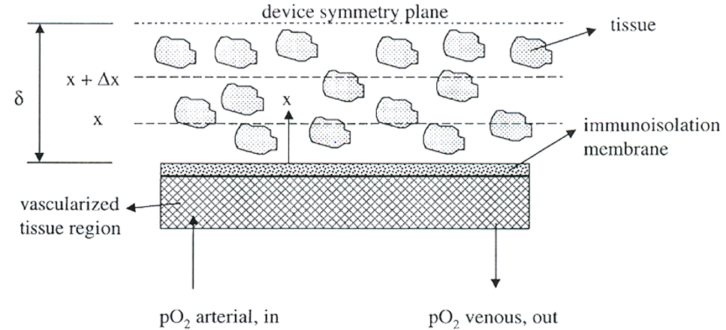
Planar Bioartifical Organ
Bioartifical organs are medical device systems that incorporate therapeutic cells sandwiched between permselective membranes
Allow for oxygen, nutrient/waste, and therapeutic agents (e.g., insulin) to permeate
The membrane pores are too small for components of the host’s immune system cannot cross (system is __________________)
Device system is adjacent to vascularized tissue or a polymer matrix that promotes vascularization

Slide 21
Planar Bioartifical Organ
Looking at a steady-state 1D diffusion system within the device, our mass balance simplifies to:
Our two boundary conditions are a symmetry condition:
And a constant surface concentration:

Slide 22
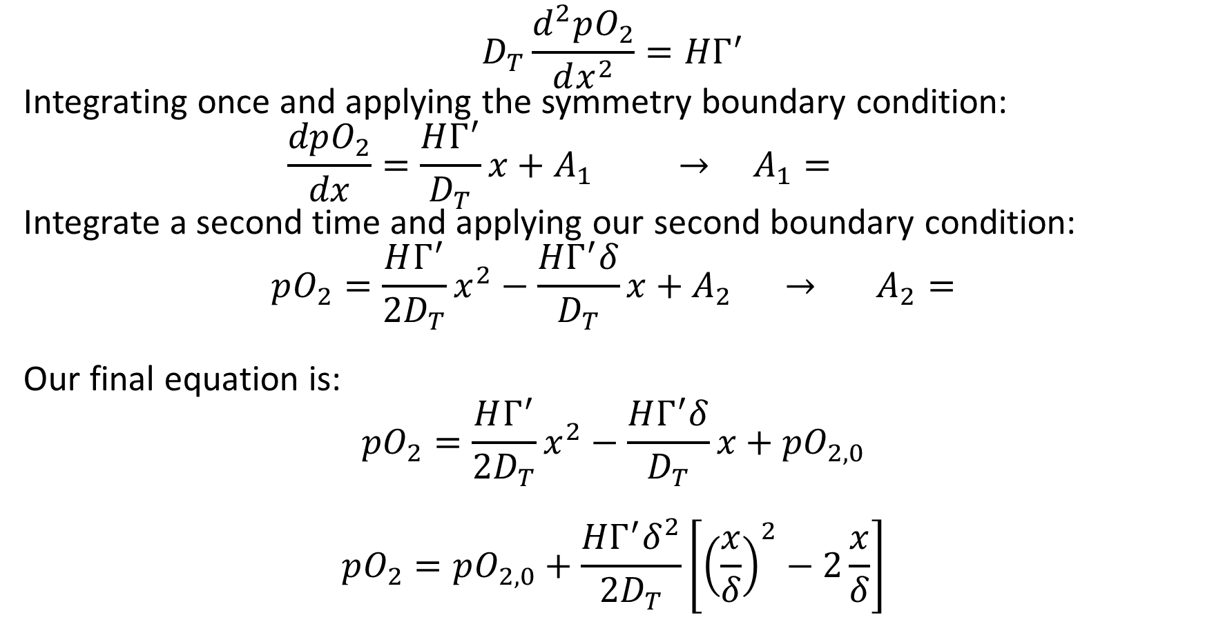
Planar Bioartifical Organ
$$D_{T}\frac{d^{2}pO_{2}}{dx^{2}}=HΓ^{′}$$
Integrating once and applying the symmetry boundary condition:
$$\frac{dpO_{2}}{dx}=\frac{HΓ^{′}}{D_{T}}x+A_{1} → A_{1}=$$
Integrate a second time and applying our second boundary condition:
$$pO_{2}=\frac{HΓ^{′}}{2D_{T}}x^{2}−\frac{HΓ^{′}δ}{D_{T}}x+A_{2} → A_{2}=$$
Our final equation is:
$$pO_{2}=\frac{HΓ^{′}}{2D_{T}}x^{2}−\frac{HΓ^{′}δ}{D_{T}}x+pO_{2,0}$$
$$pO_{2}=pO_{2,0}+\frac{HΓ^{′}δ^{2}}{2D_{T}}\left[{\left(\frac{x}{δ}\right)}^{2}−2\frac{x}{δ}\right]$$

Slide 23
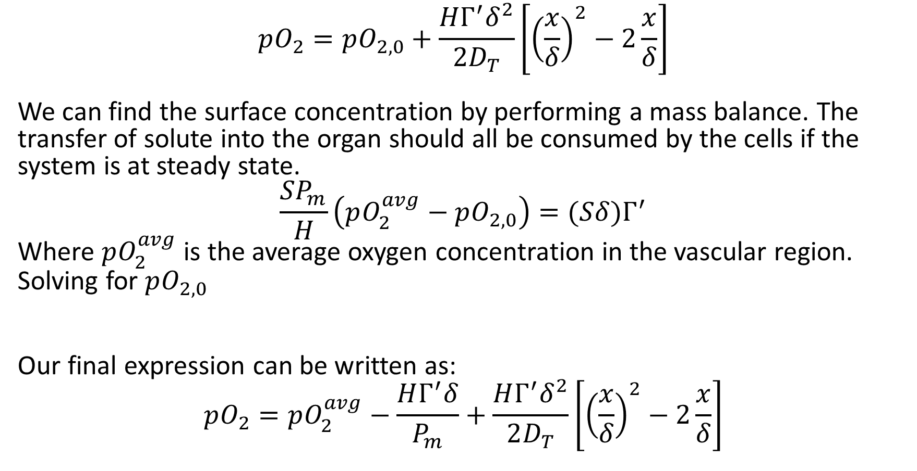
Planar Bioartifical Organ
$$pO_{2}=pO_{2,0}+\frac{HΓ^{′}δ^{2}}{2D_{T}}\left[{\left(\frac{x}{δ}\right)}^{2}−2\frac{x}{δ}\right]$$
We can find the surface concentration by performing a mass balance. The transfer of solute into the organ should all be consumed by the cells if the system is at steady state.
$$\frac{SP_{m}}{H}\left(pO_{2}^{avg}−pO_{2,0}\right)=(Sδ)Γ^{′}$$
Where $pO_{2}^{avg}$ is the average oxygen concentration in the vascular region.
Solving for $pO_{2,0}$
Our final expression can be written as:
$$pO_{2}=pO_{2}^{avg}−\frac{HΓ^{′}δ}{P_{m}}+\frac{HΓ^{′}δ^{2}}{2D_{T}}\left[{\left(\frac{x}{δ}\right)}^{2}−2\frac{x}{δ}\right]$$

Slide 24
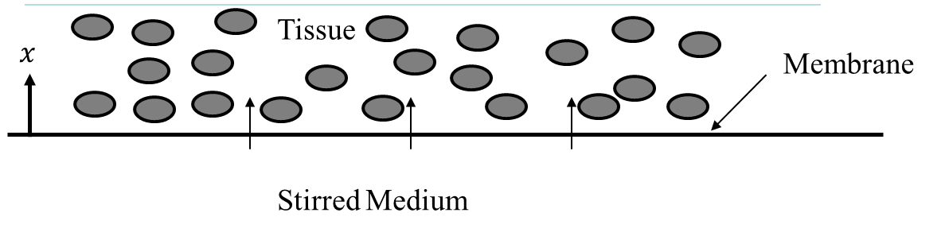
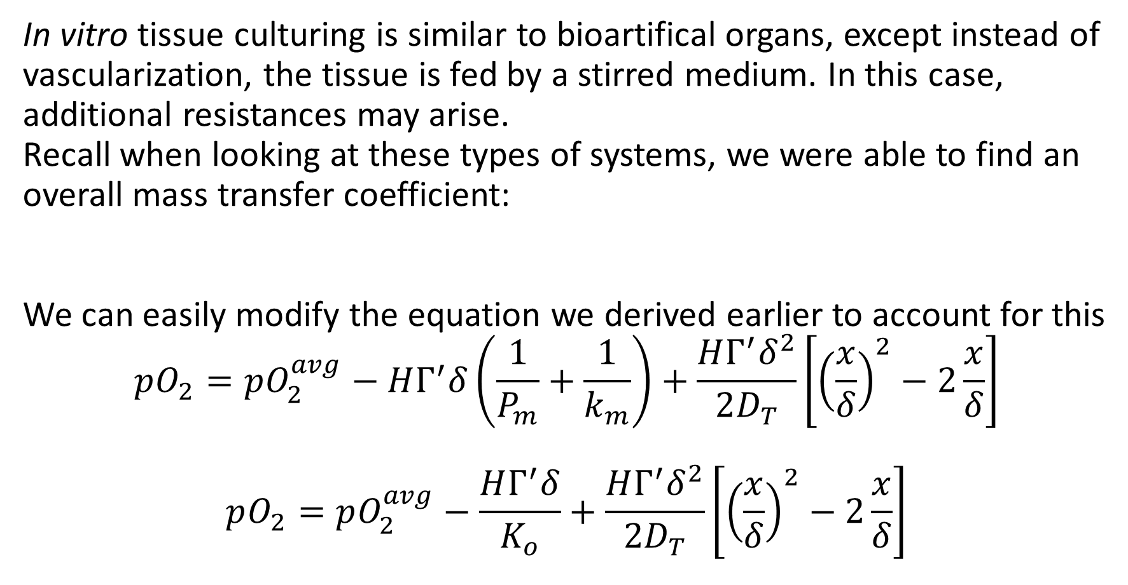
Planar Engineered Constructs
In vitro tissue culturing is similar to bioartifical organs, except instead of vascularization, the tissue is fed by a stirred medium. In this case, additional resistances may arise.
Recall when looking at these types of systems, we were able to find an overall mass transfer coefficient:
We can easily modify the equation we derived earlier to account for this
$$pO_{2}=pO_{2}^{avg}−HΓ^{′}δ\left(\frac{1}{P_{m}}+\frac{1}{k_{m}}\right)+\frac{HΓ^{′}δ^{2}}{2D_{T}}\left[{\left(\frac{x}{δ}\right)}^{2}−2\frac{x}{δ}\right]$$
$$pO_{2}=pO_{2}^{avg}−\frac{HΓ^{′}δ}{K_{o}}+\frac{HΓ^{′}δ^{2}}{2D_{T}}\left[{\left(\frac{x}{δ}\right)}^{2}−2\frac{x}{δ}\right]$$

Slide 25
Planar Bioartifical Organ - Example
Consider a bioartifical organ designed for a Type 1 diabetic that has islet cells (alpha and beta pancreatic cells) seeded inside. The cells can be assumed spherical with diameters of 150 mm, with a basal oxygen consumption rate of 25.9 mM/s. Assume the cell volume fraction is 15% and the cells are suspended in a hydrogel matrix which has an effective oxygen diffusivity of 1.67 x 10⁻⁵ cm²/s. Assume the oxygen permeability of the membrane is 4 x 10⁻³ cm/s. Assume the average oxygen concentration in vascularized network feeding the organ is 68 mmHg. Determine the thickness of the bioartifical organ (in terms of number of cells thick).

Slide 26
Planar Bioartifical Organ – Solution
We are looking at a case where the half thickness is large enough that the oxygen concentration is 0 at that boundary.

Slide 27
Planar Bioartifical Organ – Solution

Slide 28
Planar Bioartifical Organ – Solution

